Slide 1


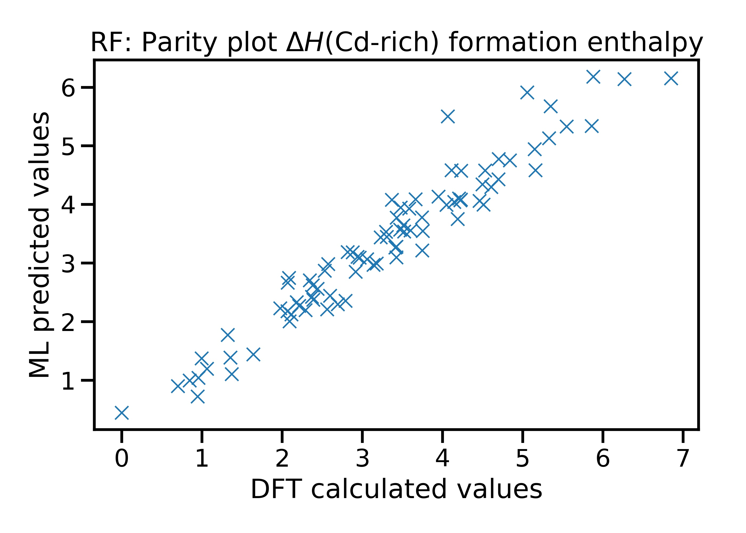
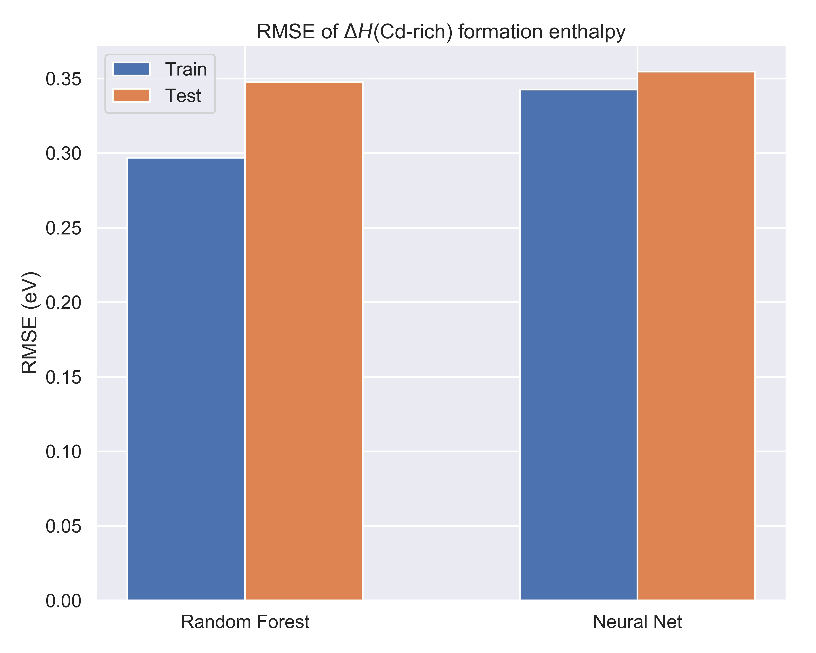
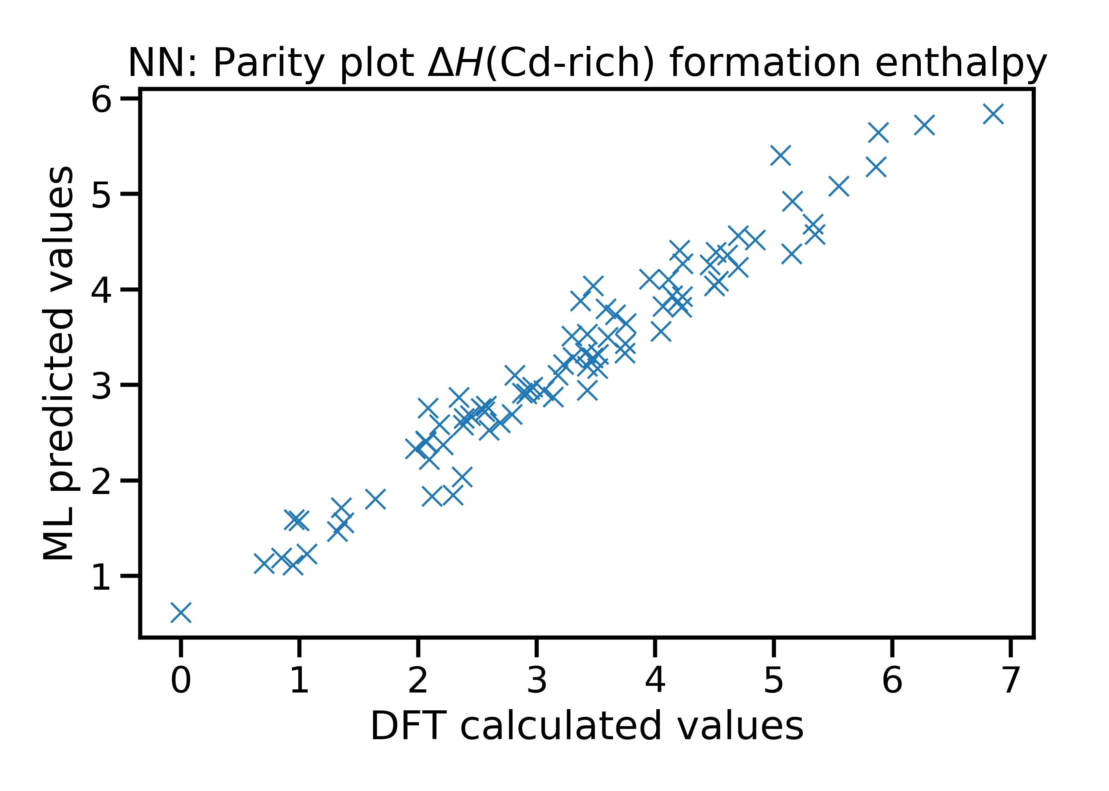
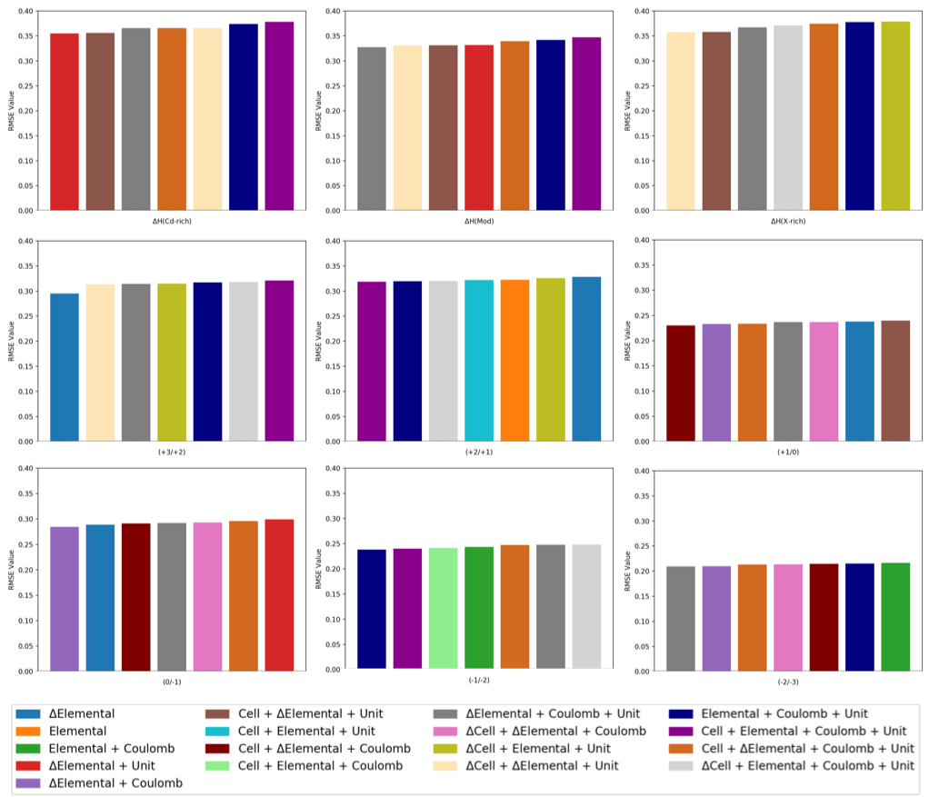
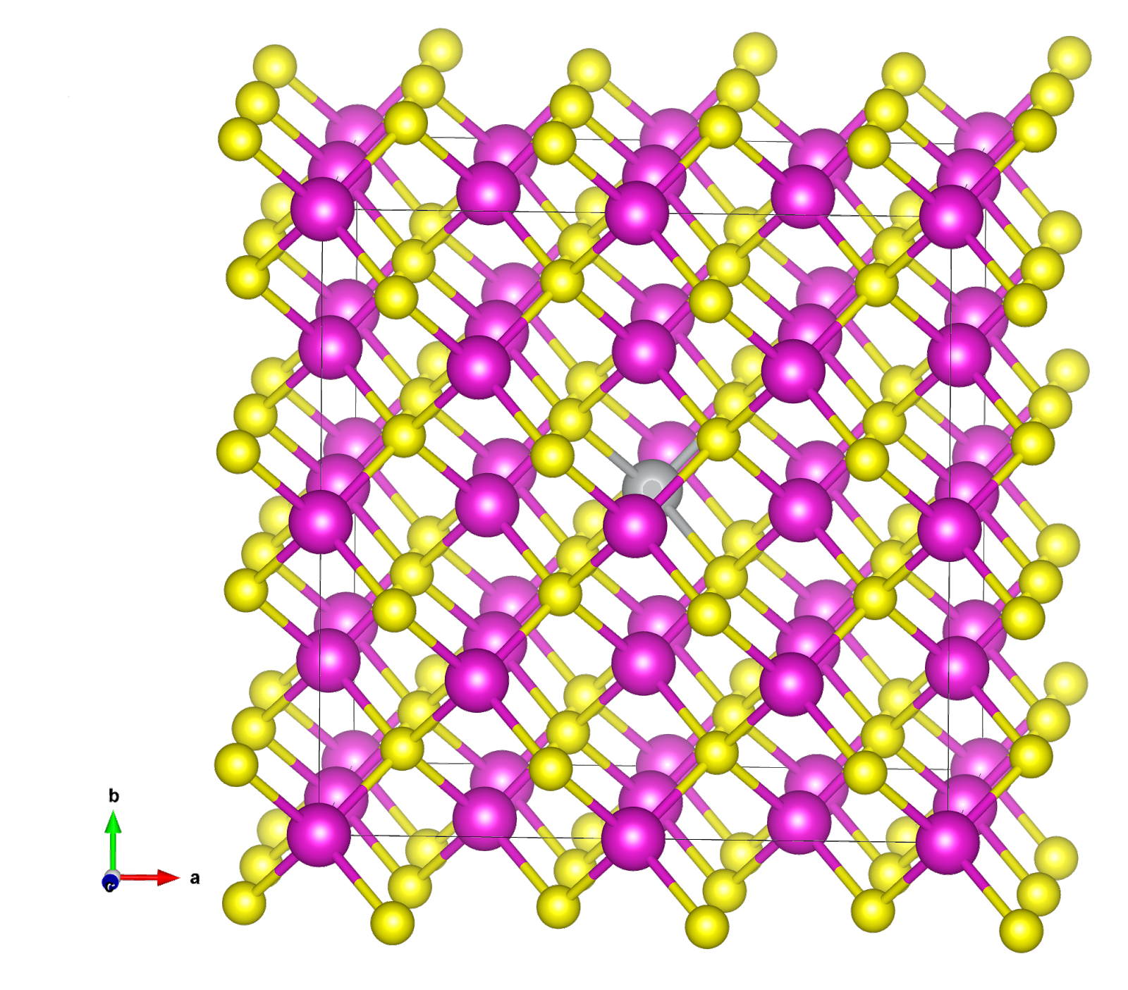
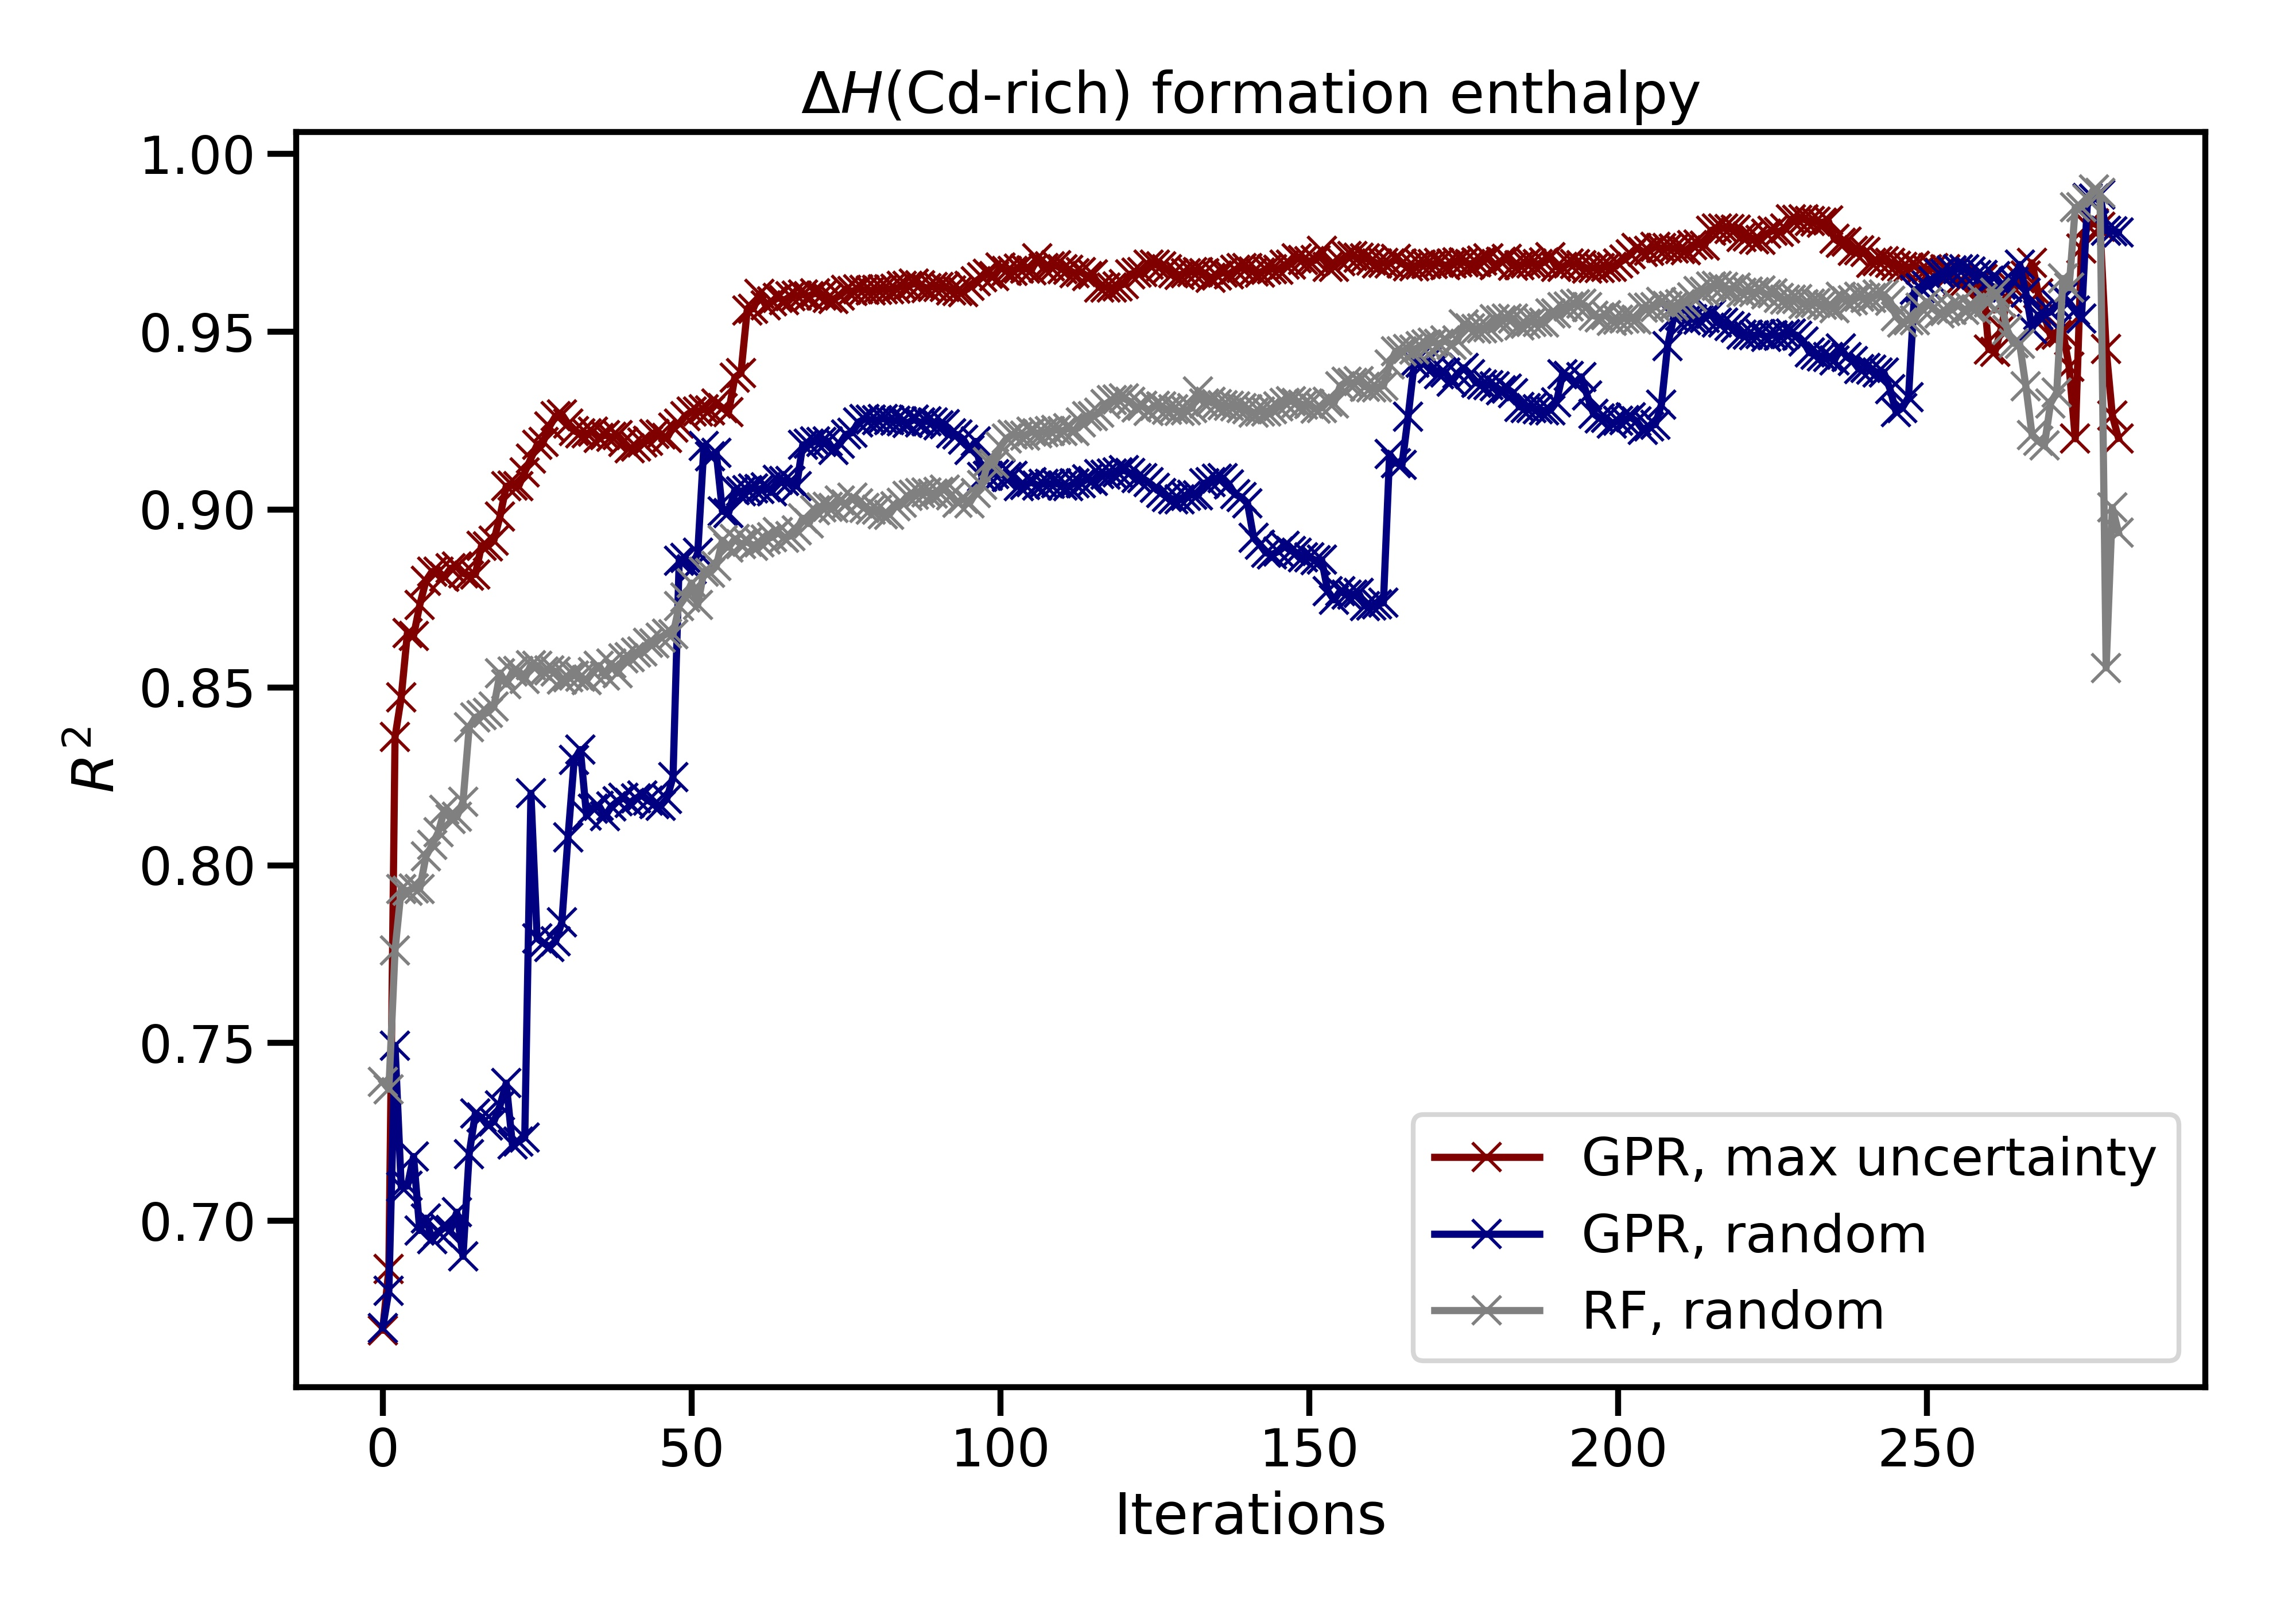
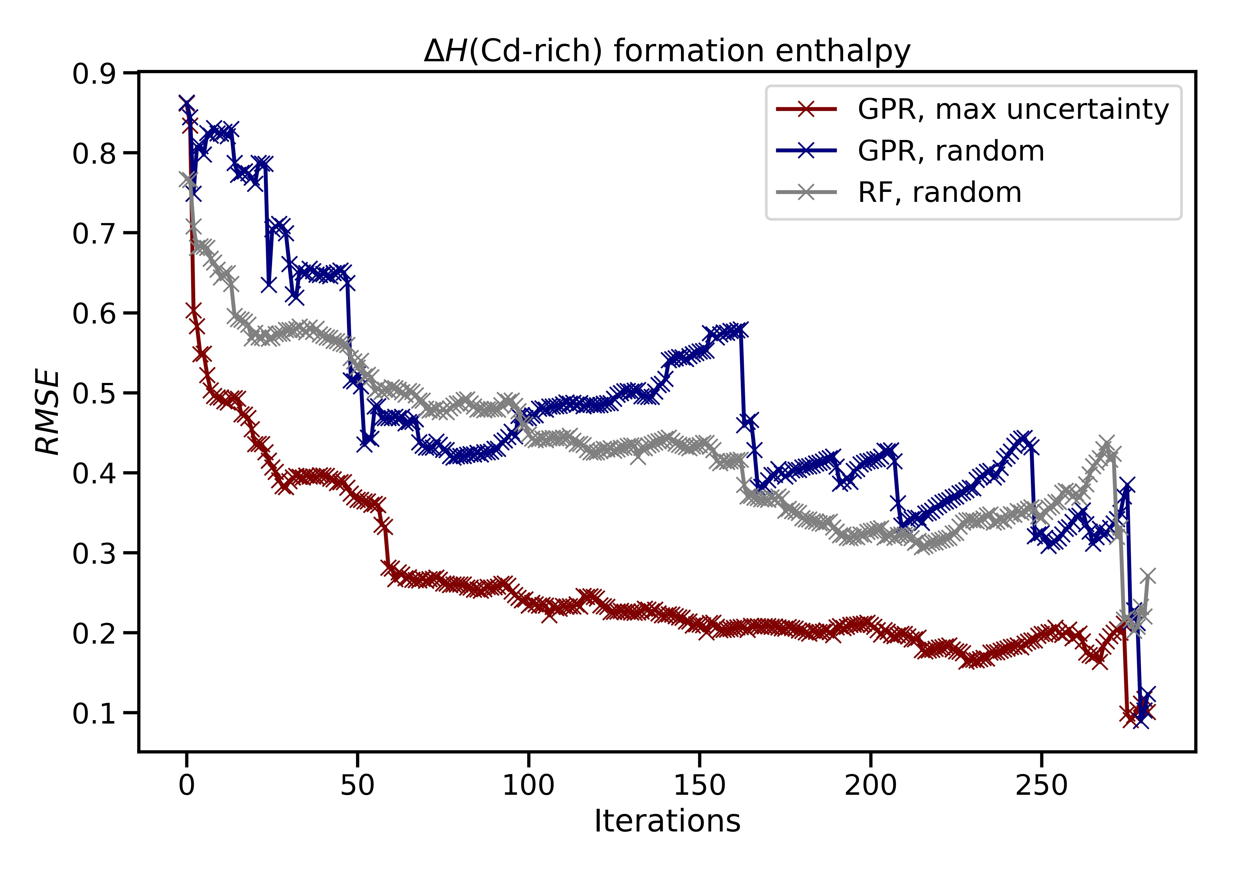
DopeDefects
Predicting impurity energy levels of semiconductors using machine learning
Ryan Beck, Lauren Koulias, Linnette Teo
Project Mentors: Argonne National Lab – Maria K. Chan, Arun Kumar Mannodi Kanakkithodi
Overview
Data Cleaning Functionalities
Neural networks
Overview: DopeDefects is an open source python package that aims to predict the enthalpy of formations, as well as the charge transition levels, of various defects embedded in Cd/chalcogenide crystals.
Available on GitHub:
https://github.com/dopedefects/dopedefects.git
Scan through the provided directory for VASP (Vienna Ab inito Simulation Package) geometry files and convert the coordinates to cartesian space
Determine the position and type of vacancy
Calculate the bond lengths and angles for the atoms surrounding the defect, as well as determining the change in comparison to a pure system
Collect all the properties into a pandas dataframe, as well as save and resume the data so that data parsing does not need to be redone
Used elemental and unit descriptors; 425 data points
Split data 6:2:2 (training:validation:testing)
Hyperparameter tuning: batch size, epoch number, number of nodes in hidden layers, learning rate, dropout rate
Motivation
Chemical space for potential solar cell materials is large
Use Density Functional Theory (DFT) computations, an ab inito method for calculating chemical properties
DFT requires significant computational resources both in time and energy costs
Number of calculations required to explore entire space is unfeasible
Possible solution: predictive models trained on small subset of calculated properties
Feature Selection
Neural net does not perform significantly better than random forest – need further optimization, more data
RMSE for Random Forrest Regression
Iterative Method using Gaussian Process Regression
Start with small subset of data to fit GPR model (10% of 315 CdTe structures)
Use model to predict mean and uncertainty (standard deviation) on remaining test points
Choose a test point that maximizes uncertainty
Add test point (with calculated value) to model and retrain
Iterate - keep adding points till satisfied
About the Data
Properties to predict
Supercell enthalpies of formation (3)
Supercell energies of charged states (6)
Descriptors of defect system (109 in total)
Elemental: elemental properties of the dopants such as group, period, ionic, atomic, & covalent radii, boiling point, atomic weight, etc.
ΔElemental: change in elemental properties between the dopant atom and the atom that it replaced
Unit: ΔH values from the unit cell calculation, conduction and valence band edges
Cell: bond angles and bond lengths for all atoms in the unit cell
ΔCell: change in the bond angles and bond lengths for all atoms between the doped and undoped cell
Coulomb: coulomb matrix for the unit cell
For each property being predicted, a different set of descriptors was the most accurate, the top 7 for each category are shown above
Overall it seems that Elemental properties are always necessary, combined with other descriptors for the most accurate results
Maximizing uncertainty using GPR vs random search helps reduce initial number of known points needed
Future Work
Multiple output predictions
Improvement of prediction for impurity transition levels
More detailed analysis into different CdX structures

